Slide 1

Hospital ER Operations Analytics
Comprehensive performance review of patient flow, triage efficiency, and demographic volume based on the 2023-2024 Dashboard Data.

Slide 2

Project Overview & Methodology
Defining the scope and objectives of our ER data analysis.

Slide 3

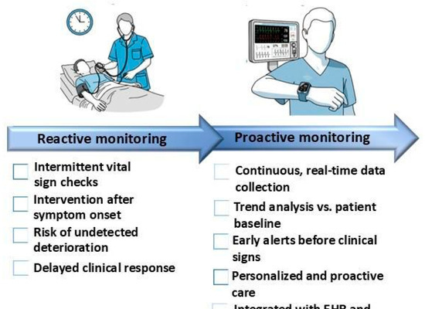
Initiative Background
Data-Driven Healthcare
This initiative leverages a comprehensive dataset of Emergency Room records to identify critical bottlenecks in patient care and operational throughput.
→
Dataset Scope: Analyzing 952 distinct patient interactions from 2023-2024.
→
Dashboard Filtering: The current analytical view isolates 479 specific records for targeted review.
→
Primary Goal: Improve SLA compliance for wait times and elevate overall patient satisfaction scores.

Slide 4

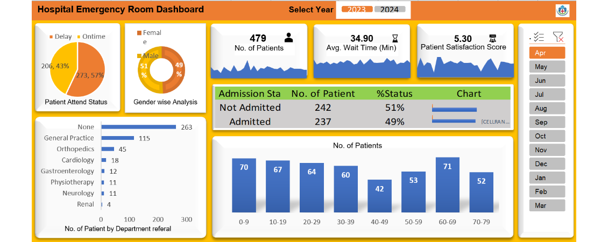
Executive Dashboard View
Fig 1.0: Master ER Dashboard. The interface aggregates key performance indicators, admission statuses, departmental referrals, and demographic distributions into a single, interactive pane of glass.

Slide 5

Core Performance Metrics
Evaluating the top-level Key Performance Indicators (KPIs).

Slide 6






Top-Level KPI Summary
Operational Baselines
479
The dashboard isolates three primary metrics that define the current state of our emergency room efficiency based on the filtered selection.
NO. OF PATIENTS
While patient volume remains steady, the Average Wait Time of nearly 35 minutes exceeds standard target SLAs. Furthermore, the Patient Satisfaction Score (5.30) indicates average-to-poor patient sentiment, directly correlating with extended wait times in the triage queue.
34.90
AVG. WAIT TIME (MIN)
5.30
PATIENT SATISFACTION SCORE

Slide 7
Patient Flow & Efficiency
Analyzing SLA compliance, attendance status, and hospital admission rates.

Slide 8
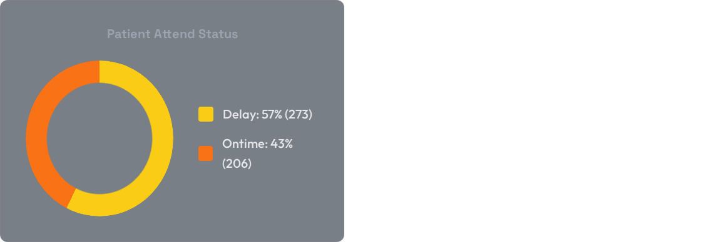
Wait Time SLA Compliance
Critical SLA Breach Identified
The visual analysis reveals a significant operational bottleneck: 57% of all patients (273 individuals) experienced a delay, failing to meet the required triage time standards.
This high volume of delayed care is the primary driver behind the low Patient Satisfaction score observed in the KPI overview. Restructuring the initial intake process is paramount.

Slide 9

Hospital Admission Rates
High Acuity Bottlenecks
The data shows an almost perfectly even split in admission outcomes, with 49% of ER visits (237 patients) resulting in a formal hospital admission.
This extremely high acuity rate requires extensive physician resources, diagnostic testing, and inpatient bed coordination. When inpatient beds are unavailable, these admitted patients board in the ER, severely restricting front-end throughput and exacerbating the 57% delay rate.

Slide 10
Departmental & Demographic Insights
Breaking down patient origins, age groups, and gender distributions.

Slide 11
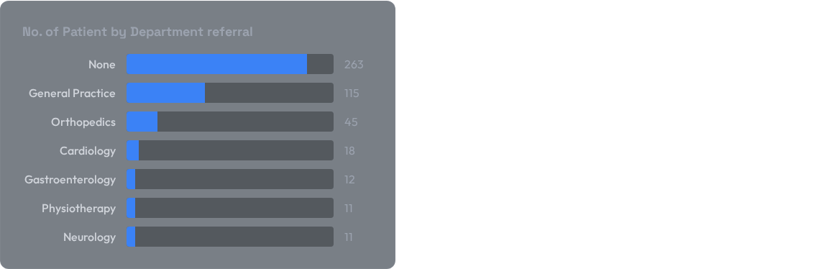
Department Referral Volume
The Walk-In Burden
The referral data clearly illustrates that the vast majority of ER patients (263 patients) arrived with "None" (no prior departmental or GP referral).
Unreferred, walk-in patients typically require more extensive initial diagnostics, administrative processing, and triage time compared to patients referred by a General Practice (115 patients). This directly impacts the triage queue speed.

Slide 12
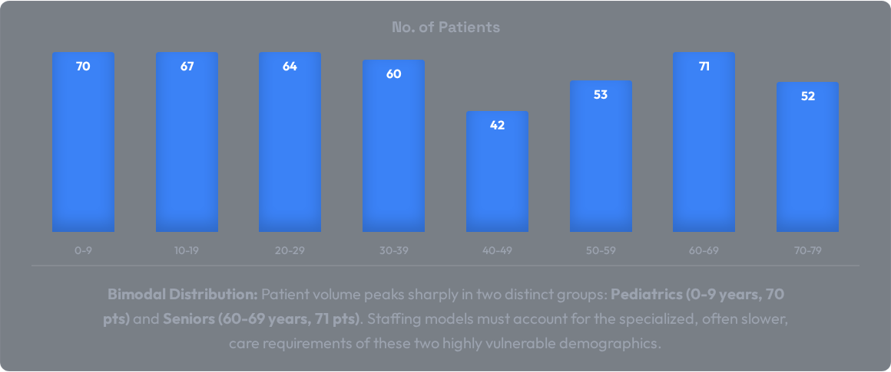
Demographic Volume (Age Groups)

Slide 13
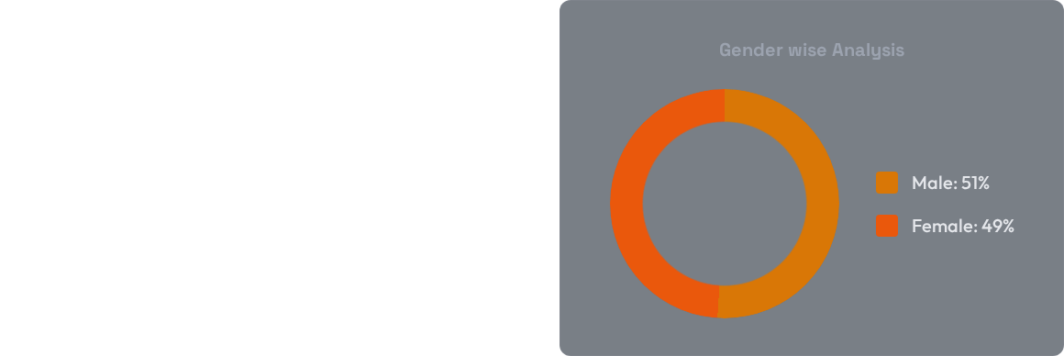
Gender-Wise Analysis
Balanced Patient Population
The dashboard indicates a nearly perfectly balanced demographic split across the analyzed dataset.
Males represent 51% of the patient volume, while Females account for 49%. This suggests that ER utilization in this sector is not heavily skewed by gender-specific ailments, and general medical staffing is appropriately aligned.

Slide 14

Strategic Action Plan
Data-Driven Interventions
Based on the visual dashboard analytics, we recommend the following immediate operational shifts:
→
Fast-Track Triage: Implement a dedicated lane for the massive volume of "None/Unreferred" walk-ins to combat the 57% Delay rate.
→
Specialized Staffing: Align pediatric and geriatric nursing specialists to match the observed bimodal volume peaks.
→
Admission Streamlining: With 49% of patients requiring admission, expedite inpatient bed turnaround to clear ER space faster.

Slide 15
Thank You
ER Dashboard Analytics & Operational Review

